Slide 1

Introduction
to Web
Development

Slide 2
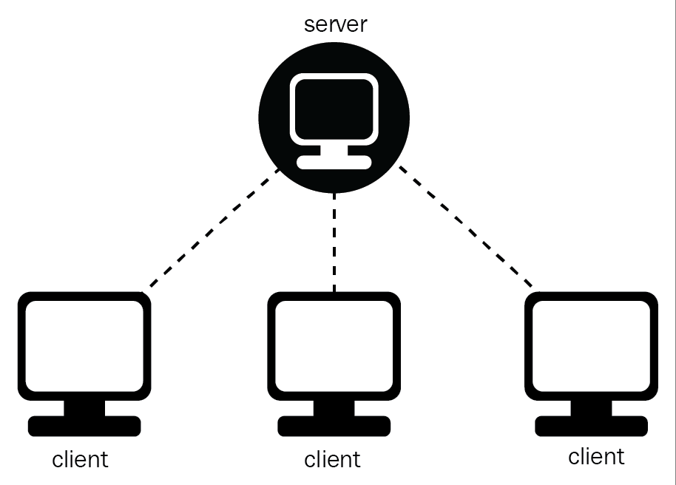




Forward today:
Introduction to the Client Server Model
HTML
CSS
Live Coding: Basic Blog Layout
Live Coding: Google’s Homepage

Slide 3
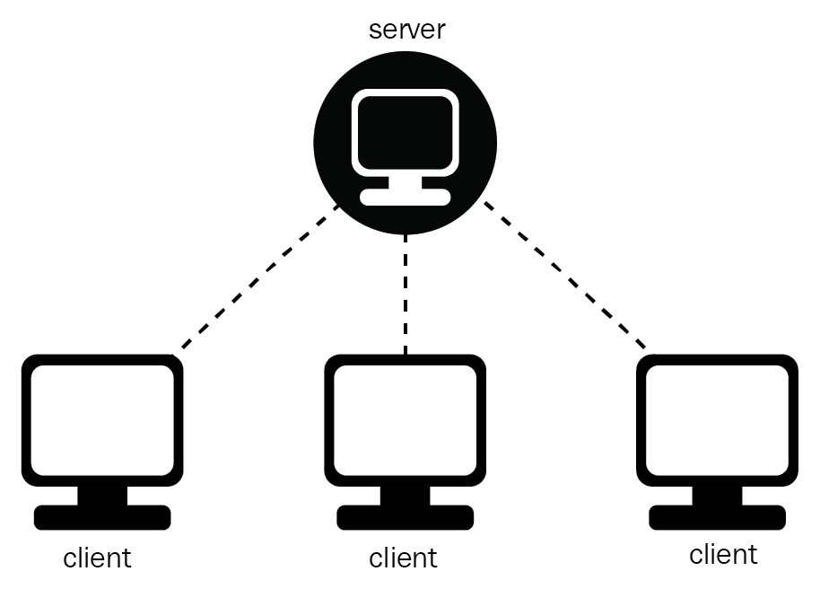
Introduction to
Client Server Model

Slide 4
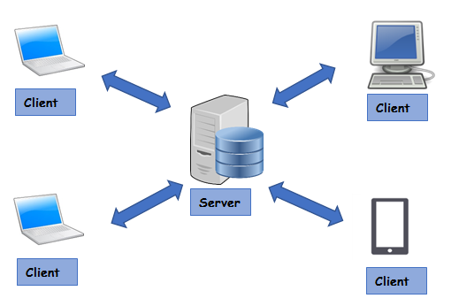
Notes:
Client is the one who makes the request and the server serves the responses. Let’s see how it works.

Slide 5
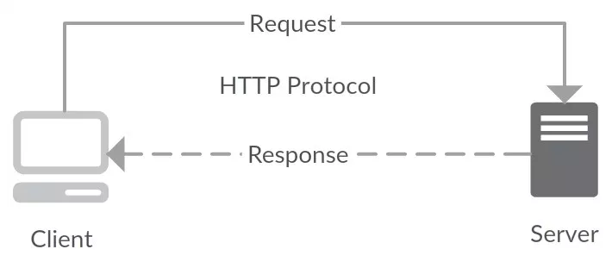
Request and Response
Notes:
A medium for communication, specifically a protocol for two systems to interact. Also called HTTP communication protocol
A protocol to ask for the required details from the server. This could be in any form of formatted data. Most commonly used formats are XML and Json.
Server responds by sending a Response in any form of formatted data, here also it could be XML or JSON.

Slide 6
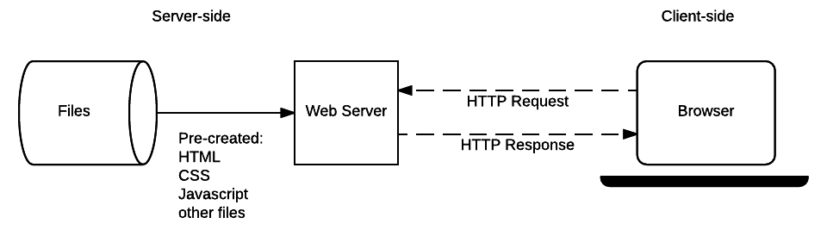
Notes:
make them understand how the search form works… POST goes to server and GET fetches the data….

Slide 7
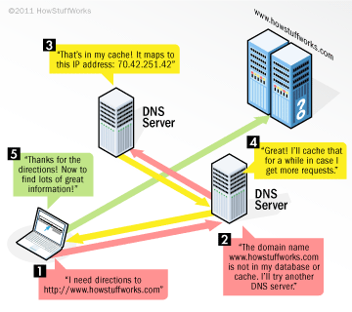
Notes:
Client is the one who makes the request and the server serves the responses. Let’s see how it works.

Slide 8

HTML
Hypertext Markup Language
Notes:
1. HTML
2. Basic syntax
3. Tags
4. Basic Tags (html head body h1...h6 p div a button input img)
5. HTML Attributes
6. Attributes Syntax
7. Self closing tags (br input img)
8. class and ids

Slide 9
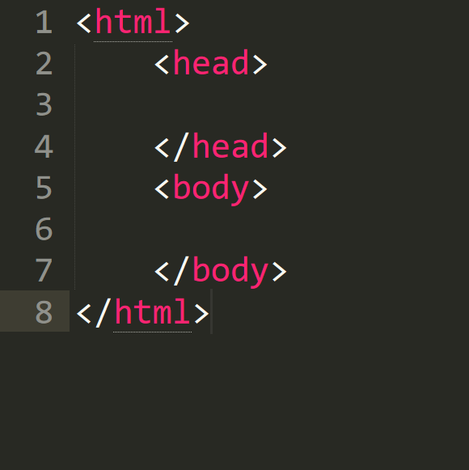
Syntax

Slide 10
Let’s get
our hands
dirty
Notes:
<!DOCTYPE html>
<html>
<head>
</head>
<body>
<h1>This is h1!</h1>
<h2>This is h2!</h2>
<h3>This is h3!</h3>
<h4>This is h4!</h4>
<h5>This is h5!</h5>
<h6>This is h6!</h6>
<a href="http://www.google.com">This is a link tag</a>
<p>
This is a paragraph. And it is cool.
But how to make text <strong>bold</strong> <i>italics</i> and <u>underlined</u>?
We use strong, i and u tags!
How do we insert a line break in a paragraph?
<br></br>
We use a br tag!
</p>
<p>
This is a new paragraph
</p>
<a href="./otherPage.html">Link to other page</a>
<img src="./someImage.jpg" />
<div>
<input type="text" />
<button>This is button</button>
</div>
</body>
</html>

Slide 11

CSS
Cascading Style Sheets

Slide 12
Syntax:
selector {
property-name: property-value;
}

Slide 13
CSS Selectors:
Selector | Example | Example description
.class | .intro | Selects all elements with class="intro"
#id | #firstname | Selects the element with id="firstname"
* | * | Selects all elements
element | p | Selects all <p> elements
element,element | div, p | Selects all <div> elements and all <p> elements
element element | div p | Selects all <p> elements inside <div> elements

Slide 14
color:
h1 {
color: red;
}

Slide 15
background-color:
h1{
background-color: red;
}
Notes:
Can use rgba() notation

Slide 16
background-image:
body {
background-image: url(image.jpg);
background-size: cover;
}

Slide 17
linear-gradient:
p {
background-image: linear-gradient(to bottom right, red, yellow);
}

Slide 18
font:
p {
font-family: "Times New Roman", Times, serif;
font-style: italic;
font-size: 30px;
font-weight: bold;
}

Slide 19
Width and Height:
p {
height: 200px; width: 50%;
}

Slide 20
border:
p {
border: 3px solid red;
border-radius: 10%;
}

Slide 21

box-model:

Slide 22
padding:
p {
padding-top: 50px;
padding-right: 30px;
padding-bottom: 50px;
padding-left: 80px;
padding: 50px 30px 50px 80px;
}

Slide 23
margin:
p {
margin-top: 50px;
margin-right: 30px;
margin-bottom: 50px;
margin-left: 80px;
margin: 50px 30px 50px 80px;
}

Slide 24
float:
p {
float: left;
}

Slide 25
hover:
p:hover {
background-color: yellow;
}
Notes:
A link has 4 state:
link
visited
hover
active

Slide 26
transform:
p: hover {
transform: scale(2) rotate(10deg) translate(80px , 43px);
}

Slide 27
animation:
p {animation: myMove 2s infinite;}
@keyframes myMove {
0% {left: 0px;}
25% {left: 275px;}
50% {left:550px;}
75% {left:275px;}
100% {left:0px ;}
}

Slide 28
Live Coding I:
Basic Blog
Layout

Slide 29
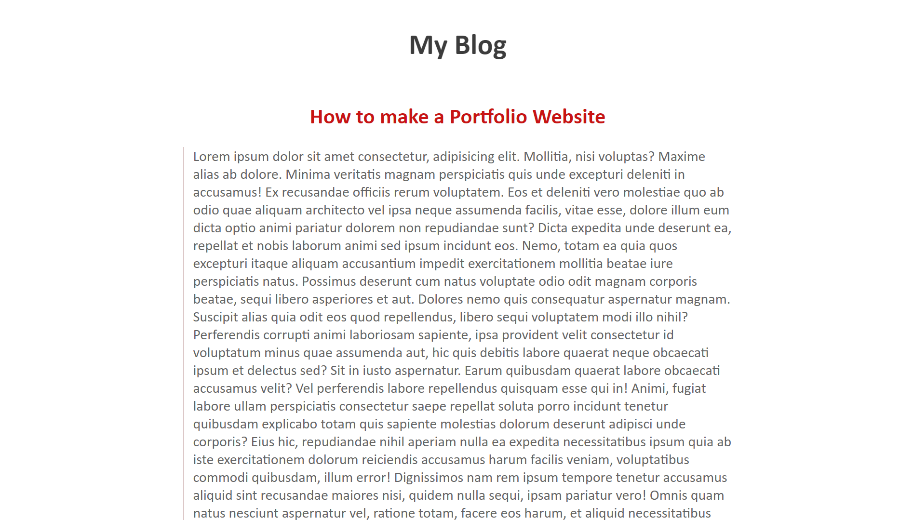
What we will make

Slide 30
Live Coding II:
Google’s
Homepage Clone

Slide 31
First we will write down the basic structure of an HTML page
<html>
<head>
<title> Homepage</title>
</head>
<body>
</body>
</html>

Slide 32
The Next comes header .Our header consist of navbar having list with two links and a sign In button.
<header>
<nav>
<ul id="nav_bar">
<li class="nav_links"><a href="#">Gmail</a></li>
<li class="nav_links"><a href="#">Images</a></li>
<li id="sign_in"><a href="#">Sign In</a></li>
</ul>
</nav>
</header>

Slide 33
Now let’s add some css to our header.
body{
margin: 0;
padding:0;
font-family: 'Lucida Sans', 'Lucida Sans Regular',
'Lucida Grande', 'Lucida Sans Unicode', Geneva, Verdana, sans-serif;
}
header{
width: 100%
}
ul{
list-style: none;
}

Slide 34
a{
text-decoration: none;
color: inherit;
}
#nav_bar{
float: right;
}
#nav_bar li{
display: inline-block;
padding: 8px;
}

Slide 35
.nav_links{
text-decoration: underline;
}
#sign_in{
background-color: dodgerblue;
color:white;
font-weight: 600;
margin: 25px;
padding: 7px 15px;
border-radius: 3px;
}

Slide 36
Next Comes an image tag.
<div class="google">
<a href="#" class="google_link"><img src="http://i1381.photobucket.com/albums/ah215/mzartdesigns/google-logo_zpspkcztsjo.png" alt=" photo google-logo_zpspkcztsjo.png"/></a>
</div>

Slide 37
Here is the CSS to our image.
.google .google_link{
text-align: center;
display: block;
margin-top:200px;
clear: both;
margin-bottom: 20px;
}

Slide 38
Now we have to add search-bar to our google homepage.
<div class="form">
<form>
<input type="text" id="input" placeholder="Type your search here..." />
</form>
</div>

Slide 39
Here comes the CSS to our search-bar.
.form{
text-align: center;
}
#input{
padding:20px;
width:400px;
}

Slide 40
Last thing we are left with is two buttons
Google search and I’m feeling lucky
<div class="button">
<input type="submit" value="Google search">
<input type="submit" value="I'm feeling lucky">
</div>

Slide 41
A simple CSS applied to our buttons
.button{
text-align: center;
margin:20px;
}

Slide 42
Thank you

